Slide 1
Ch 4 – Looping structures
CIS 142

Slide 2
Review from Chapter Three
Pseudo code is a mix of human-like and actual programming languages.
Conditions are implemented using the if structure.
Boolean Algebra – True and false, (AND, OR, NOT)
The rand() function generates a whole number from 0 to a library defined number (i.e. 32,767)
The srand() function tells the rand() function to produce a pseudorandom number every time it is executed.
Time(null) functions returns the current time in seconds
Notes:
printf (line1\nline2\nline3\n”);

Slide 3
loops
There are many different situations that require a looping technique
Playing a game until the player wins, loses, or quits
Displaying a electronic menu (skip the dishes, bank)
Calculating the amortization schedule for your student loan
Drinking a health potion as long as a player’s health is low.
Maintaining autopilot status until a flight crew turns it off
Processing employee payroll data until the last employee is handled

Slide 4
Psuedocode
Let’s say you wanted to process “employee payroll data” at a company.
You could try to write individual code for each employee
Process Bob’s payroll
Process Jenny’s payroll
.
.
Process Karen’s payroll
LONG CODE = SLOW PROGRAM
What if you hire/fire someone? Most companies don’t have a full time programmer on staff to deal with the problems
What if you hire 500 people?

Slide 5
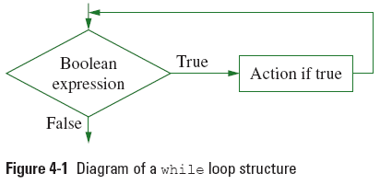
The while Loop
Instead we could use a “loop” and some variables.
while (Boolean expression - true or false)
{
--the code to loop
}
Loop body

Slide 6
Psuedocode
So in the case where we want to keep processing employee payroll until we have reach the end of the employee file
while ( )
process Employee’s payroll
loop
! end-of-file

Slide 7
Psuedocode
What if we had two pay types? (Salary and hourly wages)
while ( end-of-file != true)
{
if pay-type == salary
then pay = SalaryAmount
else
then pay = hours * rate
end if
}

Slide 8
Psuedocode
What if we had a menu that we wanted to display until the user selected a “Quit” option? We want the program to run through the loop first.
do
{
Display menu
} while ( user-selection != quit )

Slide 9
Psuedocode
Now add in all the other stuff!
do
{
display menu
if user-selection == payroll
{
while ( end-of-file != true)
{
if pay-type == salary
then pay = SalaryAmount
else
then pay = hours * rate
end if
}
}
} while ( user-selection != quit )

Slide 10
Additional Operators
Sometimes we might want to add a variable to the loop to make it count up or down for us, so we know how many times we’ve gone through the loop.
x = x + 1;
x++;
Try it out!

Slide 11
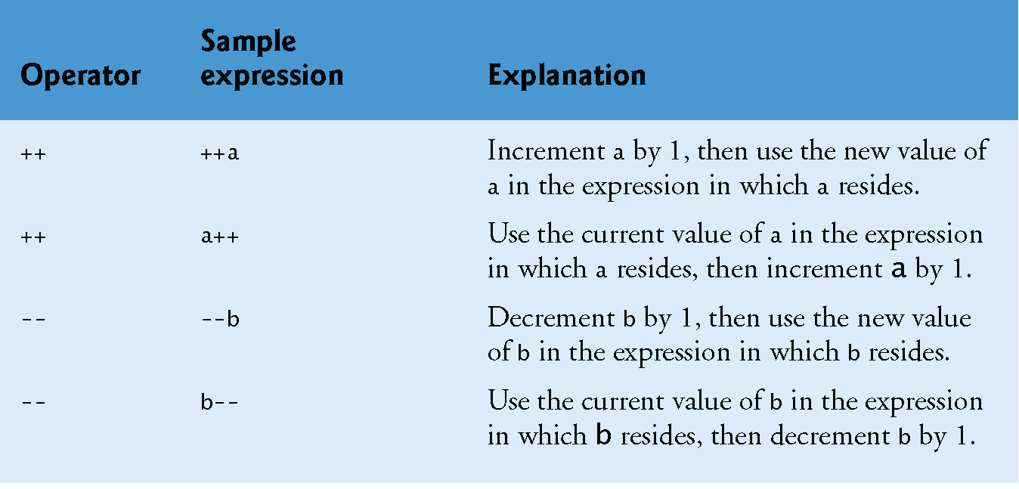
Additional Operators

Slide 12
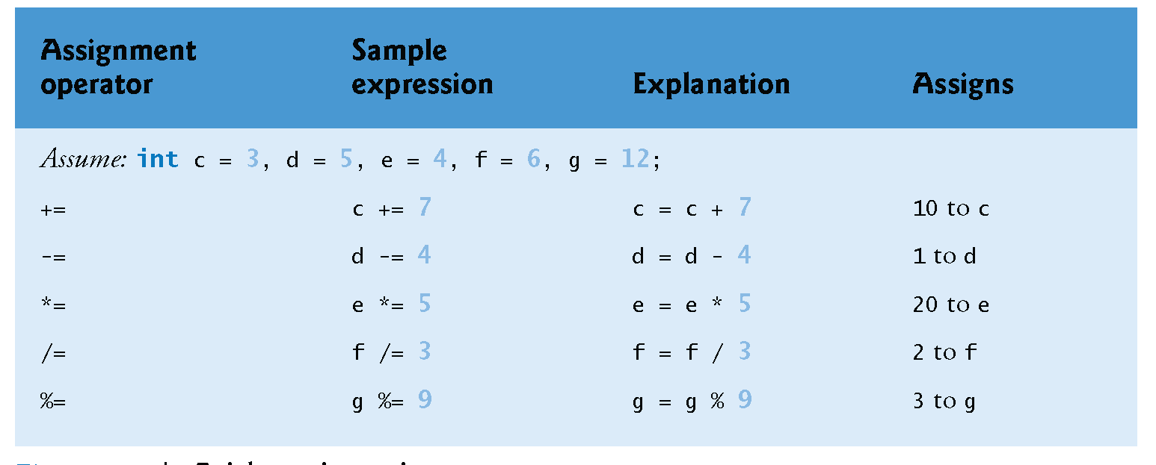
Additional Operators

Slide 13
There are three types of loops
While loop
Condition is at the top of the loop
Do . .. While loop
Program runs through the loop at least once and condition is at the bottom
For loop
Program loops for a set amount of times
for(variable initialized, conditional expression, increment/decrement)

Slide 14
Break and continue statements
Break gets you out of a loop
Continue jumps the program over the remainding code in the loop

Slide 15
System Calls
You can actual call all types of linux or dos commands from within the C program code.
int main ()
{
system(“clear”);
return 0;
}

Slide 16
